Slide 1

Mike Arkle
Competency Portfolio
www.infratec-uk.com

Slide 2
Competency Summary
Category | Accreditation Body | No. | Expiry
Emergency First aid at work (Lvl 3) | Qualsafe Awards | 3024684 | 14/02/2026
PAL - Static Boom (1b) | IPAF | OP/2633866 | 30/09/2029
PAL - Static Boom (3a & 3B) | IPAF | OP/2243040 | 31/10/2027
ECS – Highways Electrical Registration Scheme | HEA | H0234304 | 07/01/2028
National Highways Safety Passport | National Highways | 14-0013927 | 15/02/2026
CPCS – Appointed Person | CSCS | 40613024 | 30/11/2027
CPCS – Crane Lift Supervisor | CSCS | 40613024 | 30/11/2027
CPCS – Slinger / Signaller | CSCS | 40613024 | 30/11/2027
Working at Height | Qualsafe Awards | 3021032 | 15/02/2026
Confined Space Safe Entry & Self Rescue | IIRSM | CS-02 10056 | 12/02/2026
Safe Moving & Handling (Lvl 2) | Qualsafe Awards | 3291706 | 20/02/2027
www.infratec-uk.com

Slide 3
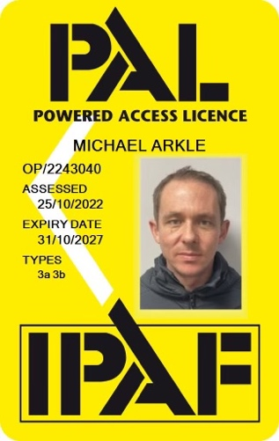
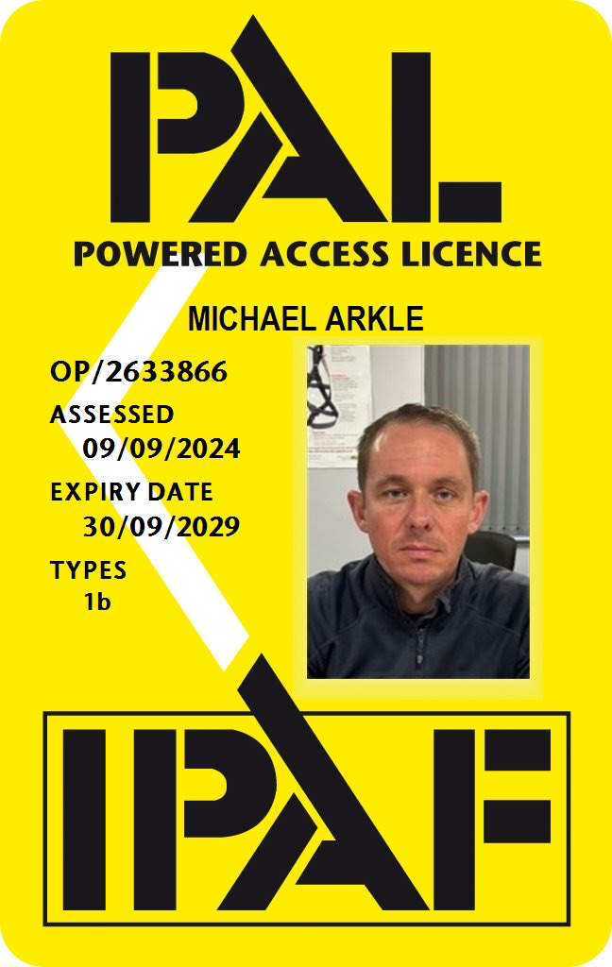
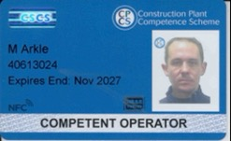
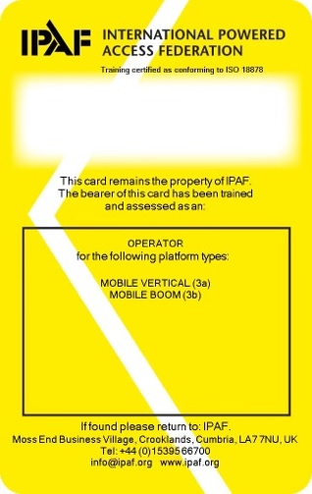
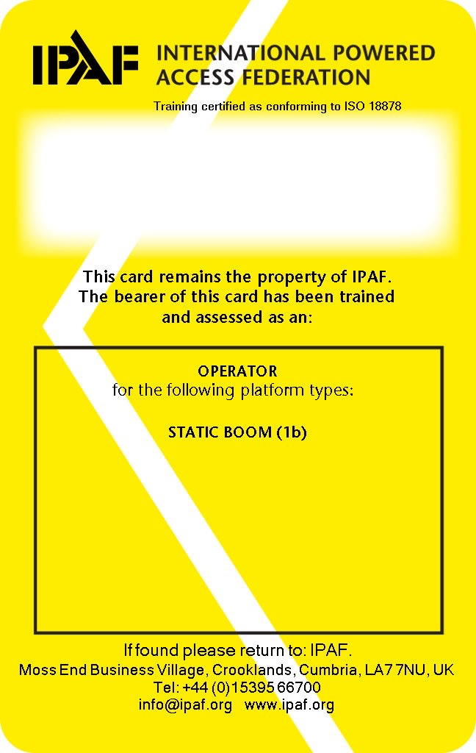
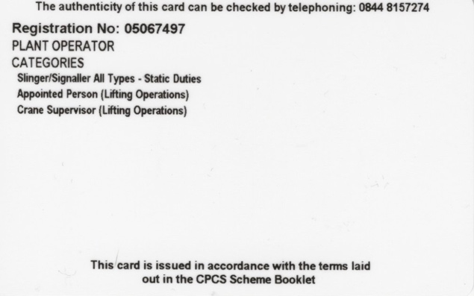
Competency Cards
CPCS
IPAF
IPAF
www.infratec-uk.com

Slide 4
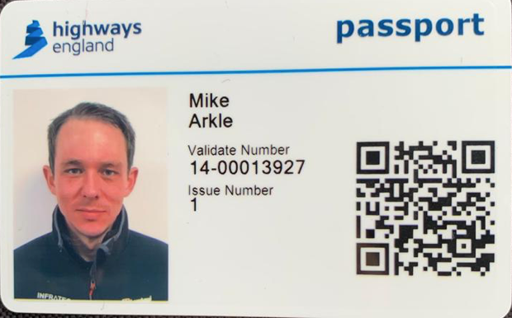
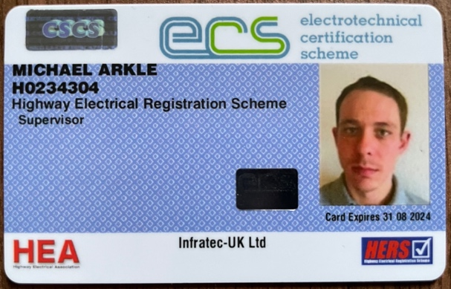
Competency Cards (cont.)
National Highways Safety Passport
CSCS
www.infratec-uk.com

